Slide 1
Density dependence The dependence of a per capita life history parameter on population size or density
Reading: vandermeer and Goldberg p7-19; p28-29

Slide 2
Logistic growth (continuous time)
Logistic growth model can be derived assuming
r is linearly related to food available
Food available is linearly related to population size
See vandermeer and Goldberg p. 14-17

Slide 3
Logistic growth (continuous time)
r: intrinsic growth rate at low population size (1/time)
K: carrying capacity (number)
N(t): size of the population at time, t.

Slide 4
Logistic growth (continuous time)
Per capita growth rate decreases linearly
Has the general solution:
see http://www.math.usu.edu/~powell/ysa-html/node8.html or differentiate the solution with respect to time to see it satisfies the logistic equation ordinary differential equation. Check t=0 gives N₀, check t to infinity

Slide 5
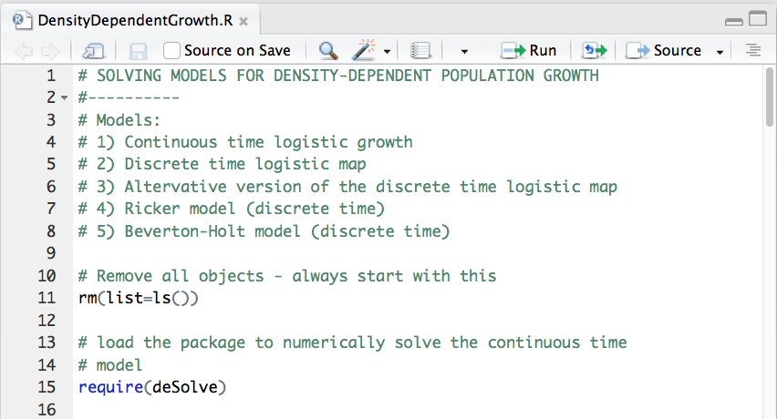

Slide 6
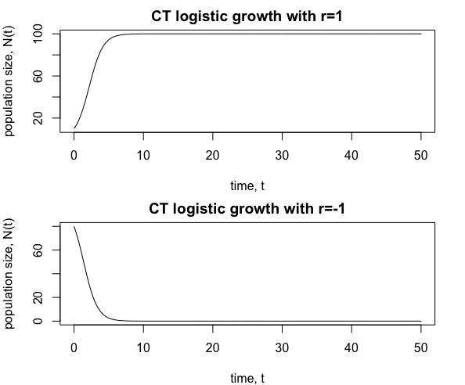
Logistic growth (continuous time)

Slide 7
Equilibrium points
Values of N(t) such that
Equilbria can be unstable
Stability of equlibrium can be determined by a line-arrow diagram

Slide 8
Logistic growth (continuous time)
N(t) = 0 is stable when r < 0
N(t) = K is stable when r > 0

Slide 9
Logistic growth (discrete time)
As from p28 vandermeer and Goldberg. This model has historical significance, but..
… this is a poor population model because population size can be negative:
i.e. find N₁ and N₂ for N₀ = 70, K = 100, and λ=5
K is not the carrying capacity for this model: the positive equilibrium is K(λ-1)/λ
Turchin: Complex Population Dynamics has a good discussion of discrete time models with density dependence and their limitations

Slide 10
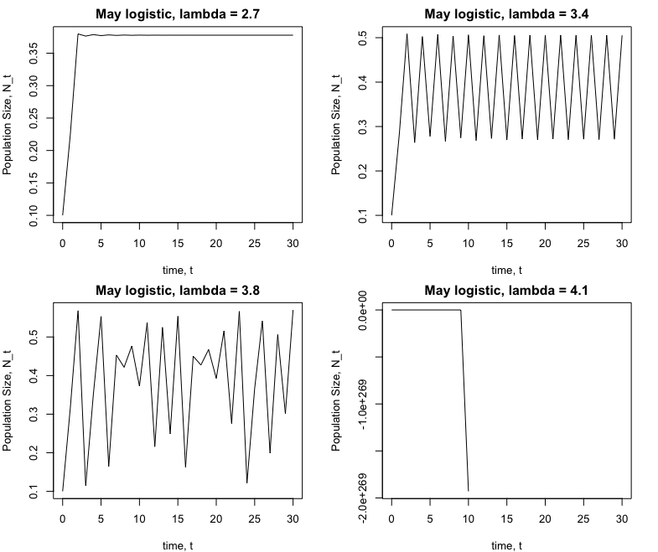
Notes:
X_{t+1} = rX_t*(1-X_t/K)
Top (L-R): r=2.7, r=3.4.
Bottom (L-R): 3.8, 0.5

Slide 11
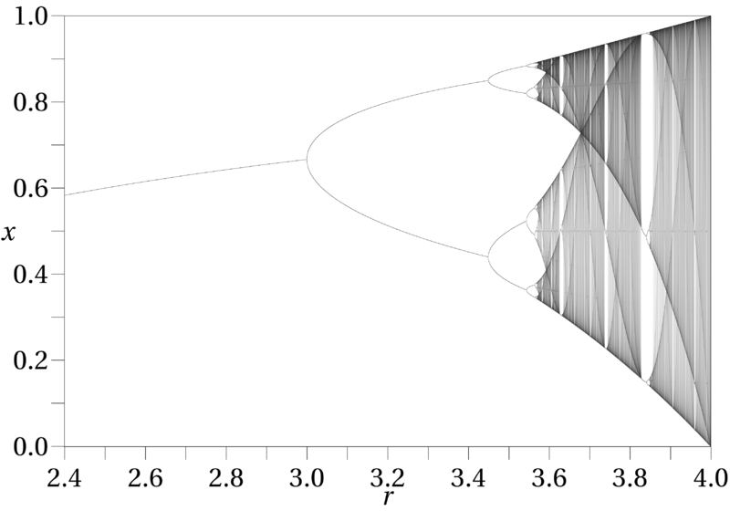

Slide 12
Logistic growth (discrete time)
K is the carrying capacity, but negative values are still possible

Slide 13
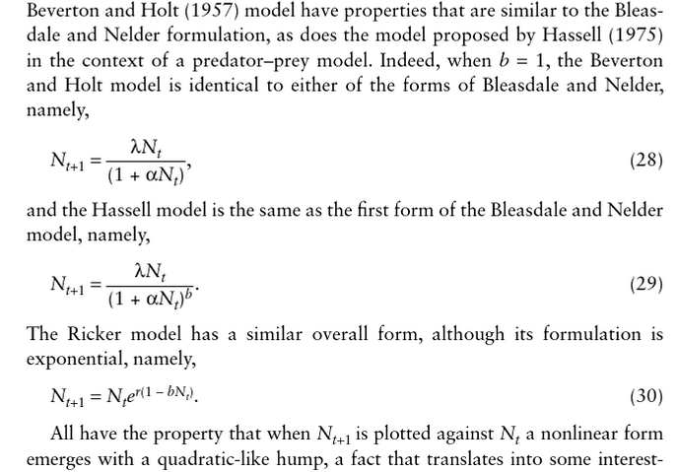
DT Density dependence
Vandermeer and Gordon p29

Slide 14
Discrete time models of density-dependent population growth
per capita
growth rate
Beverton-Holt
Logistic
Ricker

Slide 15
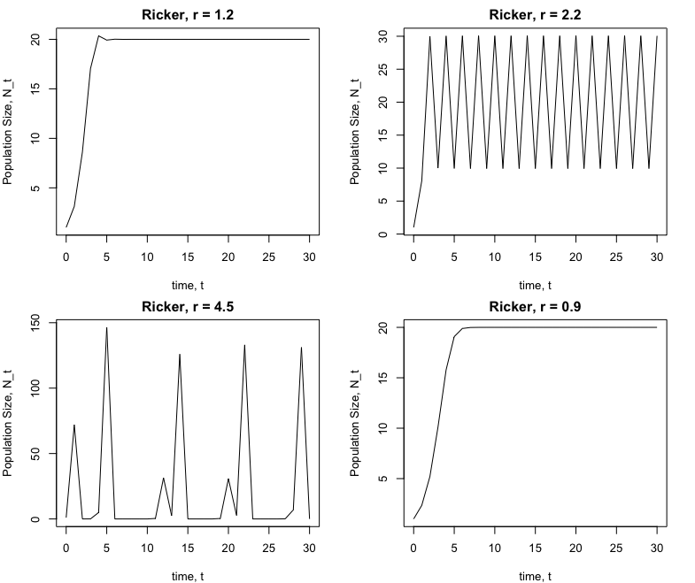

Slide 16
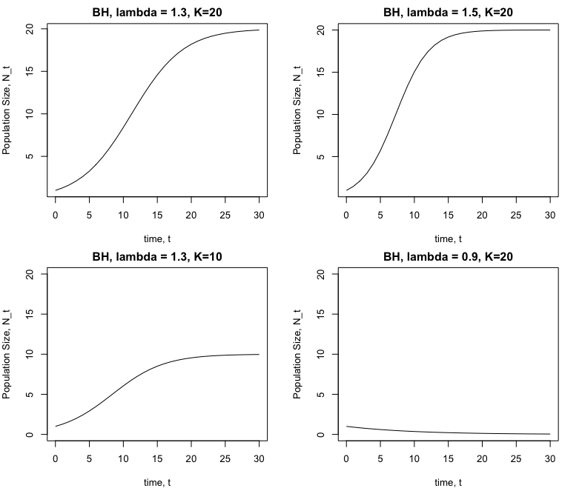

Slide 17
Models | Dynamics
Geometric (DT exponential) | a
CT exponential | a
CT logistic growth | a,b
Alternative DT logistic map | a,b,c,d
Ricker | a,b,c,d
Beverton-Holt | a,b
a. Equilibrium at 0; b. Equilibrium at K;
c. Periodic cycles; d. Chaos

Slide 18
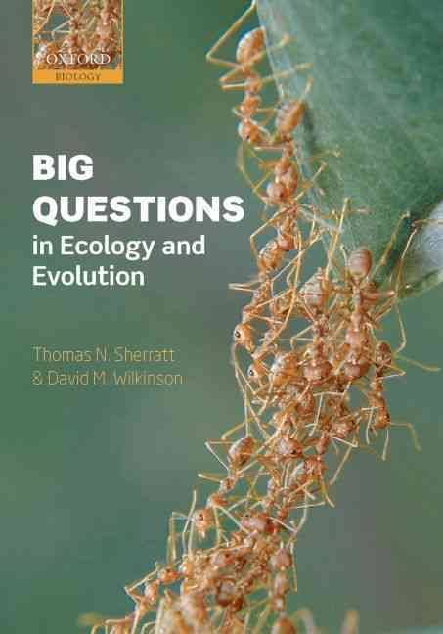
Do biological populations exhibit chaotic dynamics?

Slide 19
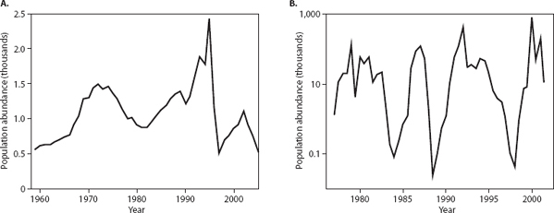
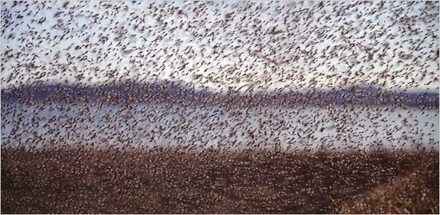
How to identify chaos?
The midge Tanytarsus gracilentus in Lake Myvatn, Iceland
Photo credit: Kenneth Chang
Notes:
Stochasticity.

Slide 20
Definition of chaos
‘a trajectory is chaotic if it is bounded in magnitude, neither periodic or approaches a periodic state, and is sensitive to initial conditions’ Cushing et al. 2002. Chaos in ecology. Academic Press.
Extreme sensitivity to initial conditions – butterfly effect
Notes:
Edward Lorenz, meterologist. If weather systems were chaotic then an almost negilible change in local wind speed in South America, such as that created by the wing flap of a butterfly, may ultimately be the difference between having or not having a hurrican in the Northern hemisphere.

Slide 21
Initial population size N₀ = 1
Initial population size N₀ = 1.01
Ricker model: r = 3.5, K=20

Slide 22
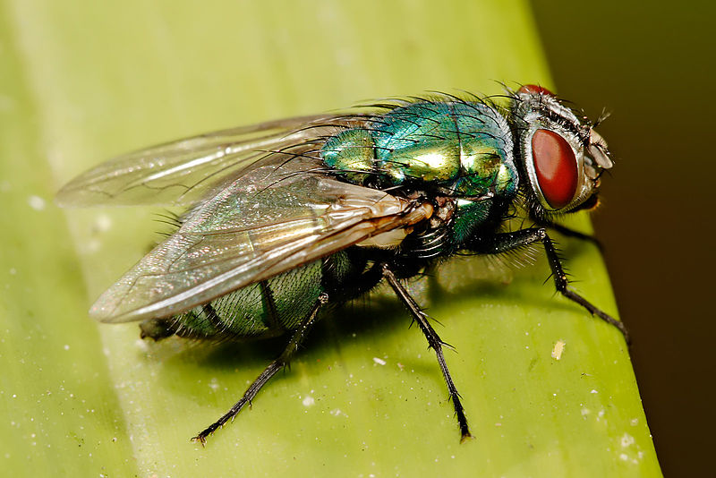
Photo credit: Fir0002/Flagstaffotos

Slide 23
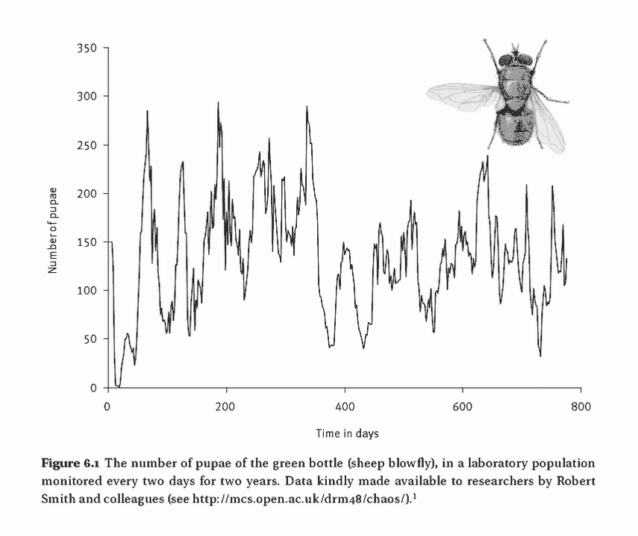

Slide 24

28 insect data sets
Only the laboratory study of blowflies by Nicholson had parameters in the chaotic regime
Could be a laboratory artifact: not subject to natural mortality from parasitic wasps

Slide 25
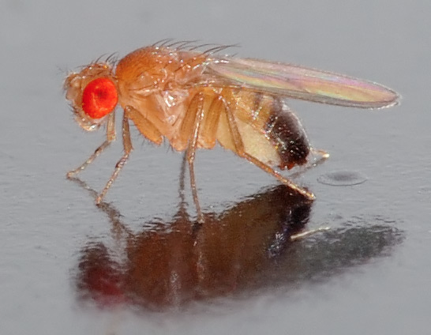
Photo credit: Andre Karwath
27 (Thomas et al. 1980) and 25 (Mueller and Ayala 1991) genetically distinct fruit fly populations
No evidence of chaos

Slide 26
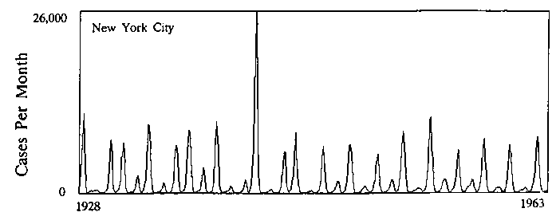
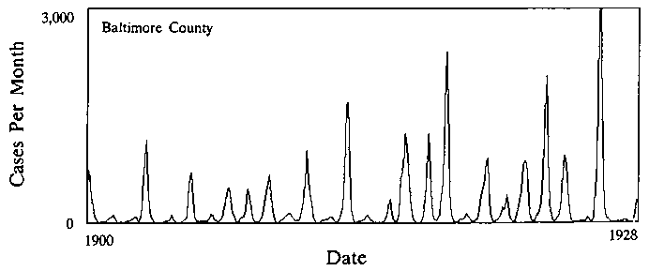
Source: Hedrich (1933)
Measles in NYC and Baltimore, 1928-1963
Analyses find the dynamics are chaotic
Doubts: birth rates have changed over time, amount of seasonal forcing required to generate chaos more than observed
Notes:
41- 43

Slide 27
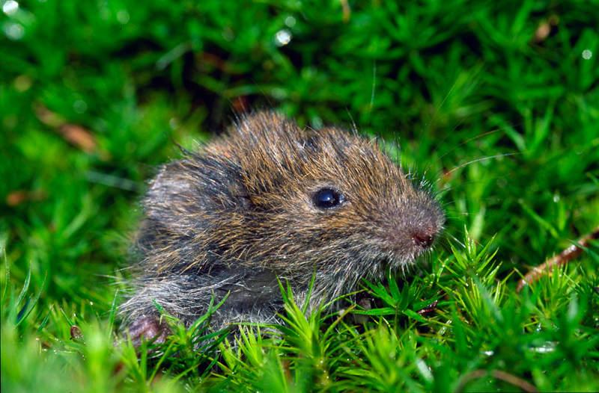
Photo credit: Fer boei
Microtus voles in western Finland
Time series shows ‘chaos superimposed’ on top of a more regular signal.
Notes:
Hanski et al. 55

Slide 28
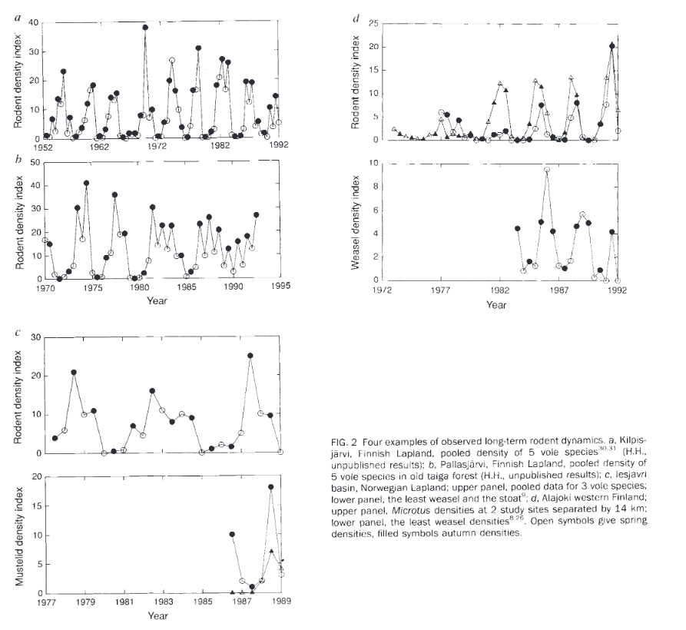
Since 1984, 3 yr cycles
Multiannual cycles absent since 1980
Hanski et al. 1993 Nature

Slide 29
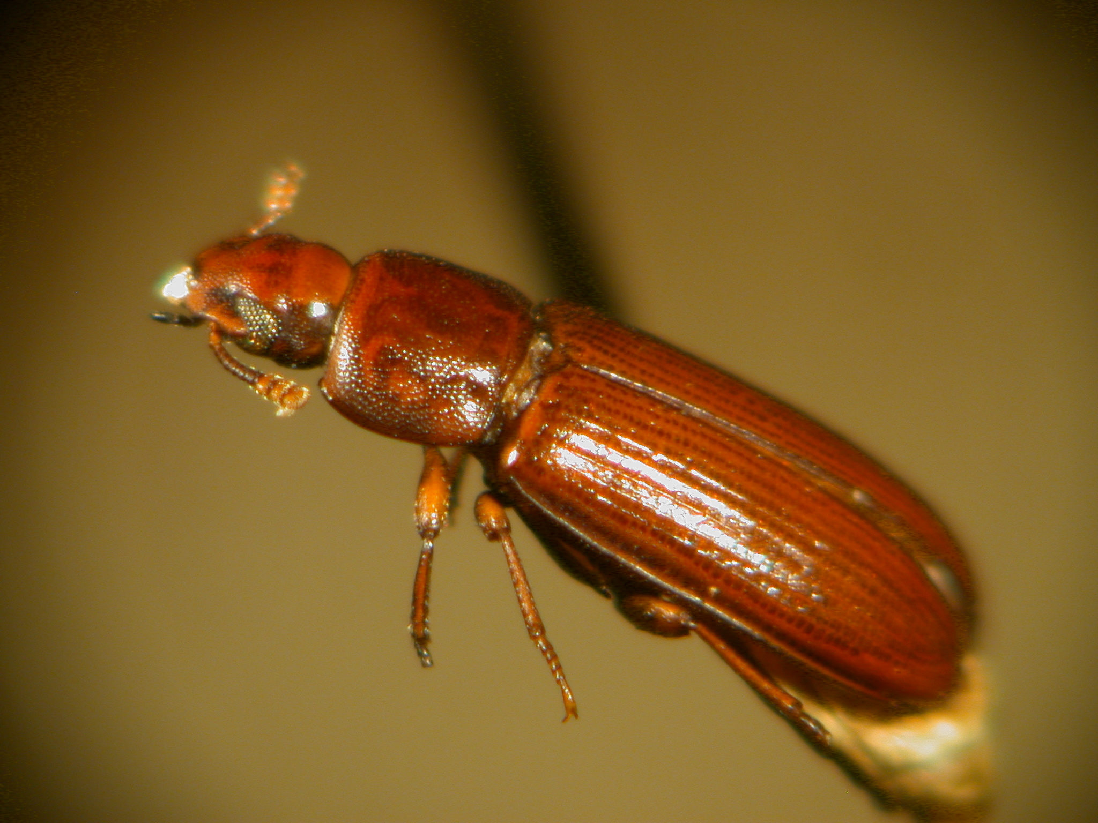
Flour beetles (Tribolium castaneum)
Artificially manipulated adult mortality and the pupae to adult recruitment rate to generate chaos
Criticism: forced the system to match the model not other way around

Slide 30
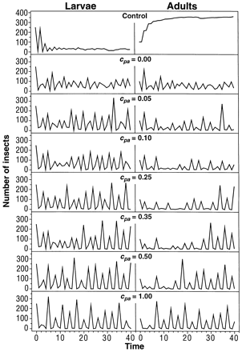
Equilibrium
chaos
period-3 cycle
Costantino et al. 1997

Slide 31
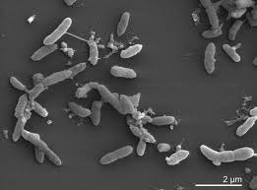
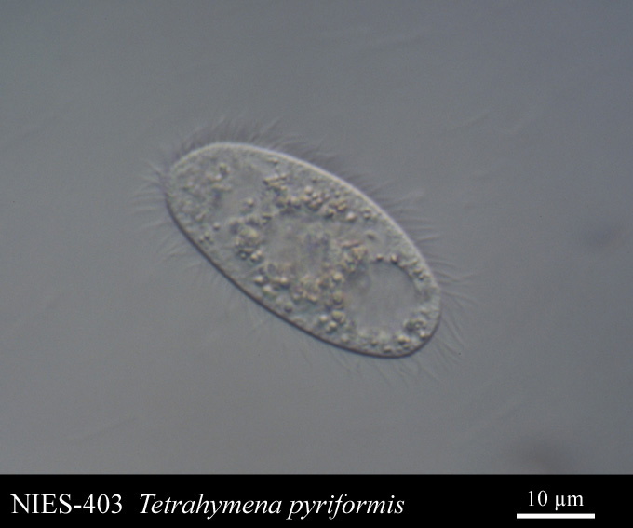
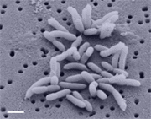
Pedobacter
Source: http://bacmap.wishartlab.com/organisms/937
Brevundimonas
Source: https://microbewiki.kenyon.edu/index.php/Brevundimonas_diminuta
source: www8.umoncton.ca
Laboratory experiments with bacteria-eating ciliate predator and two species of bacteria
Evidence of chaotic dynamics
Notes:
Becks and colleagues 61

Slide 32
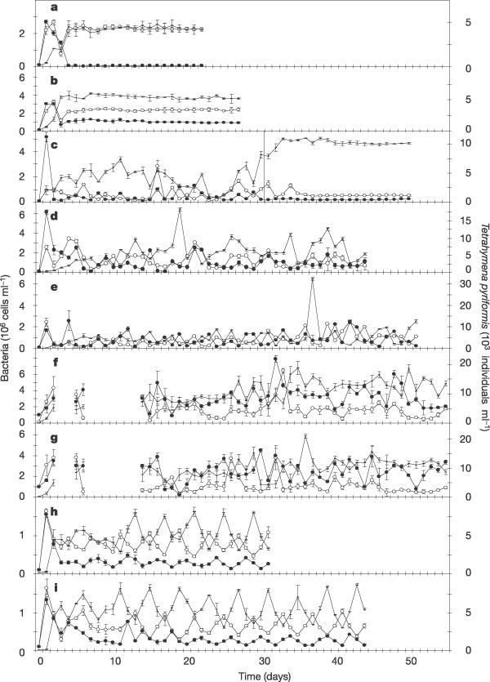
Source: Becks et al. 2005. Nature.
Notes:
Dilution rates D were as follows: a, 0.90 d⁻¹, b, 0.75 d⁻¹; c, 0.50 d⁻¹ (the line indicates the change to 0.75 d⁻¹ at day 30); d−g, 0.50 d⁻¹ (replicate experiments; no sampling took place on days 3, 4 and 7−13 in f and g); h, i, 0.45 d⁻¹ (replicate experiments). Open circles, Pedobacter (preferred prey); filled circles, Brevundimonas (less-preferred prey); horizontal bar, Tetrahymena (predator). Vertical bars represent the s.d. of triplicate samples taken separately from one chemostat.

Slide 33
Summary
“we cannot rule out the possibility … [of chaos in nature] …but the case is looking increasingly shaky, at least for multicellular organisms.
Data sets are short term and noisy.
Notes:
Becks and colleagues 61

